Slide 1
Practice C#. File system and streams.
Continuous staff improvement
Constantin andronic

Slide 2
OBjectives
Exploring the system.io namespace
General view
Getting information about drives
Getting information about file system
Reading and writing data
Streams
Reading and writing text data
Reading and writing binary information
Simplified reading-writing with the File class
Monitoring file system
Event model in monitoring
FileSystemWatcher class

Slide 3
Exploring the system.io namespace

Slide 4
Getting information about drives
// Get info regarding all drives.
DriveInfo[] myDrives = DriveInfo.GetDrives();
// Now print stats.
foreach (DriveInfo d in myDrives)
{
Console.WriteLine("Name: {0}", d.Name);
Console.WriteLine("Type: {0}", d.DriveType);
if (d.IsReady)
{
Console.WriteLine("Free space: {0}", d.TotalFreeSpace);
Console.WriteLine("Format: {0}", d.DriveFormat);
Console.WriteLine("Label: {0}\n", d.VolumeLabel);
}
}

Slide 5
Getting information about file system
FileSystemInfo Properties
Property | Meaning
Attributes | Gets or sets the attributes associated with the current file that are represented by the FileAttributes enumeration (e.g., is the file or directory read-only, encrypted, hidden, or compressed?).
CreationTime | Gets or sets the time of creation for the current file or directory.
Exists | Determines whether a given file or directory exists
Extension | Retrieves a file’s extension.
FullName | Gets the full path of the directory or file.
LastAccessTime | Gets or sets the time the current file or directory was last accessed.
LastWriteTime | Gets or sets the time when the current file or directory was last written to.
Name | Obtains the name of the current file or directory.

Slide 6
Getting information about file system
Key Members of the DirectoryInfo Type
Member | Meaning
Create() CreateSubdirectory() | Create a directory (or set of subdirectories) when given a path name
Delete() | Deletes a directory and all its contents
GetDirectories() | Returns an array of DirectoryInfo objects that represent all subdirectories in the current directory
GetFiles() | Retrieves an array of FileInfo objects that represent a set of files in the given directory
MoveTo() | Moves a directory and its contents to a new path
Parent | Retrieves the parent directory of this directory
Root | Gets the root portion of a path

Slide 7
Getting information about file system
FileInfo Core Members
Member | Meaning
AppendText() | Creates a StreamWriter object that appends text to a file
CopyTo() | Copies an existing file to a new file
Create() | Creates a new file and returns a FileStream object to interact with the newly created file
CreateText() | Creates a StreamWriter object that writes a new text file
Delete() | Deletes the file to which a FileInfo instance is bound
Directory | Gets an instance of the parent directory
DirectoryName | Gets the full path to the parent directory
Length | Gets the size of the current file
MoveTo() | Moves a specified file to a new location, providing the option to specify a new file name
Name | Gets the name of the file
Open() | Opens a file with various read/write and sharing privileges
OpenRead() | Creates a read-only FileStream object
OpenText() | Creates a StreamReader object that reads from an existing text file
OpenWrite() | Creates a write-only FileStream object

Slide 8
Getting information about file system
DirectoryInfo di = new DirectoryInfo(@"D:\Examples");
DirectoryInfo[] dirs = di.GetDirectories("*p*");
Console.WriteLine("Number of directories with a p:
{0}", dirs.Length);
foreach (DirectoryInfo diNext in dirs)
{
Console.WriteLine("The number of files and
directories in {0} with an e is {1}", diNext,
diNext.GetFileSystemInfos("*e*").Length);
}

Slide 9

Streams

Slide 10
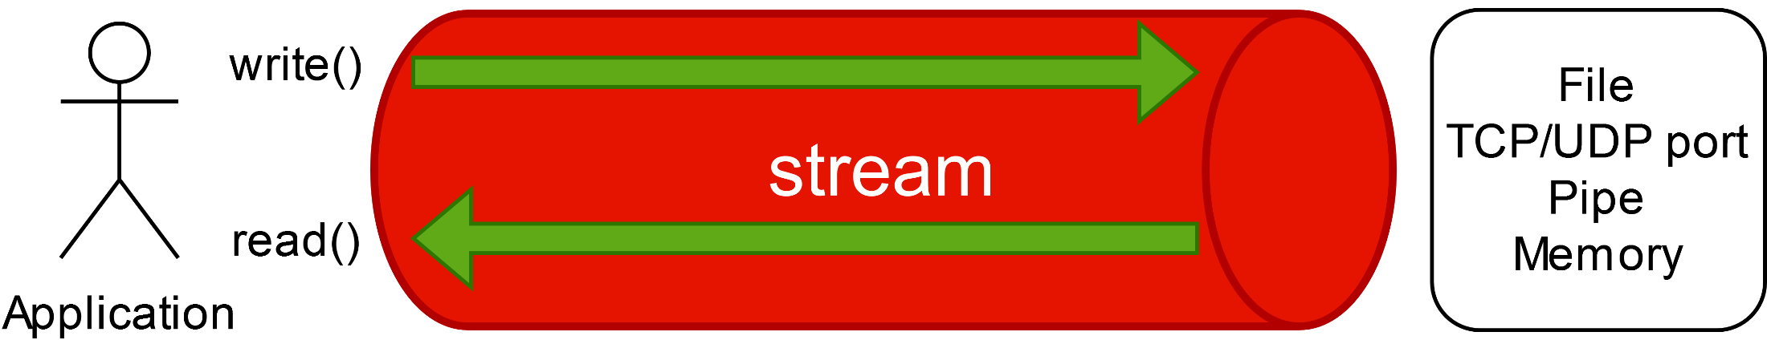
Streams
Streams are used to transfer data between a source and a consumer.
Stream deals with data serially – either one byte at a time or in blocks of manageable size. Hence, a stream can use a small, fixed amount of memory regardless of the size of the source.
If the data is being transferred from some outside source into your program, it is called reading from the stream.
If the data is being transferred from your program to some outside source, it is called writing to the stream
Streams can transport data both ways.

Slide 11
streams
Streams provide the following advantages:
A common abstraction for a variety of data sources. You can use the same interface to read/write to/from a file, network, pipe, etc.
By processing data sequentially, using streams can improve application performance
Streams reduces the amount of memory necessary to store data.
There are 3 stages when interacting with a stream
Creating/Opening the stream
Read/write data to/from the stream
Closing the stream
The abstract Stream class is the base for all streams. It defines methods and properties for three fundamental operations, readings, writing and seeking as well as for administrative tasks such as closing, flushing and configuring timeouts

Slide 12
streams
Abstract Stream Members
Member | Meaning
CanRead CanWrite CanSeek | Determines whether the current stream supports reading, seeking, and/or writing.
Close() | Closes the current stream and releases any resources (such as sockets and file handles) associated with the current stream. Internally, this method is aliased to the Dispose() method; therefore, closing a stream is functionally equivalent to disposing a stream.
Flush() | Updates the underlying data source or repository with the current state of the buffer and then clears the buffer. If a stream does not implement a buffer, this method does nothing.
Length | Returns the length of the stream in bytes.
Position | Determines the position in the current stream.
Read() ReadByte() ReadAsync() | Reads a sequence of bytes (or a single byte) from the current stream and advances the current position in the stream by the number of bytes read.
Seek() | Sets the position in the current stream.
SetLength() | Sets the length of the current stream.
Write() WriteByte() WriteAsync() | Writes a sequence of bytes (or a single byte) to the current stream and advances the current position in this stream by the number of bytes written.

Slide 13
Stream Architecture
The .NET stream architecture centers on three concepts backing stores, decorators and adapters
Backing store stream – is the endpoint that makes input and output useful such as a file or network connection. A backing store stream is hardwired to a particular type of backing store such as FileStream or NetworkStream. Deals exclusively with bytes.
Decorators stream – These feed off another stream transforming the data in some way, such as GZipStream or CryptoStream. Deals exclusively with bytes.
Adapters – Make possible to write/read data types(ex. Strings, integers or XML elements) to/from the stream.
Closing the decorator/adapter stream closes the underlying backing store stream.

Slide 14
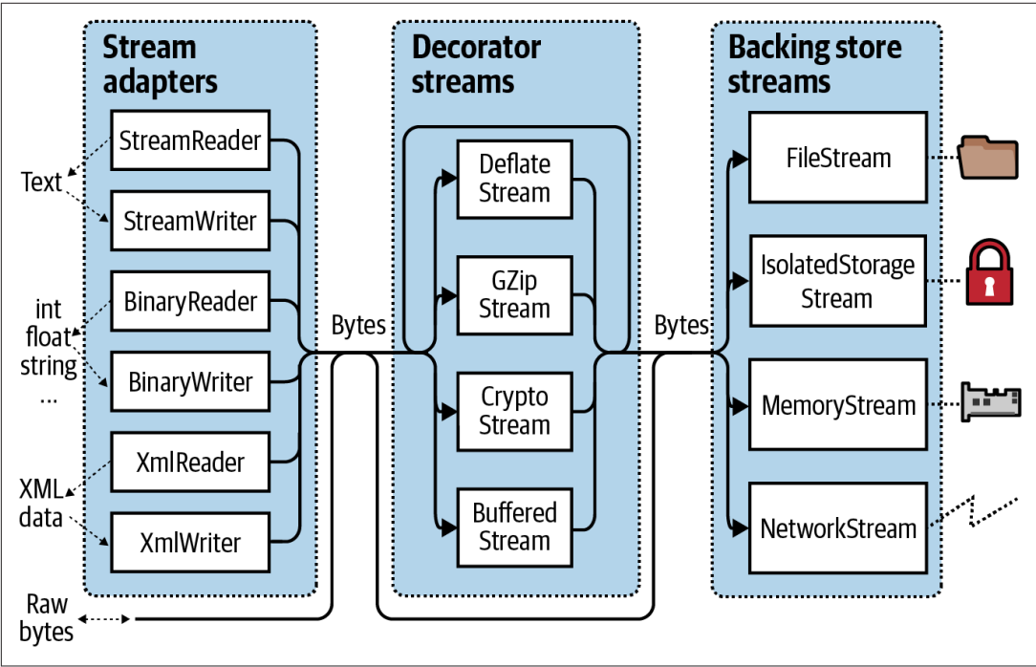
Stream Architecture

Slide 15
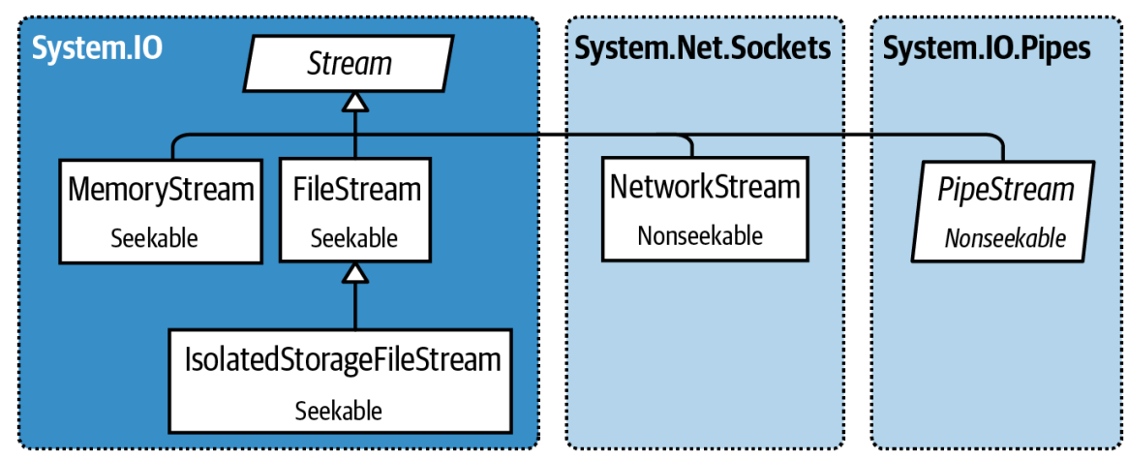
Backing store streams

Slide 16
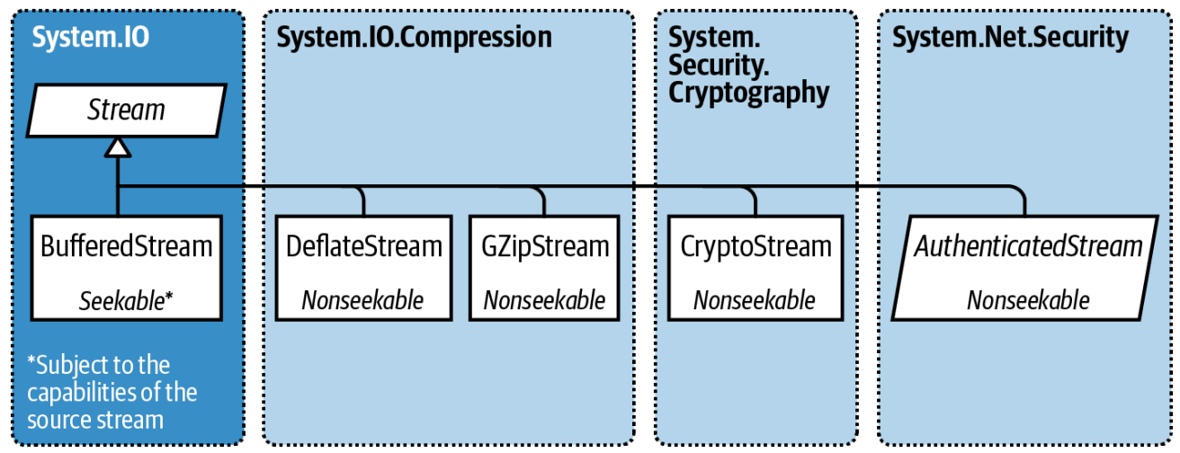
Decorator Streams

Slide 17
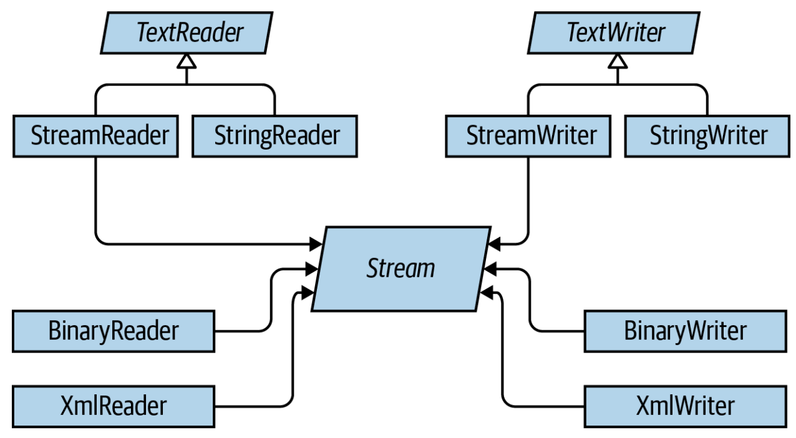
Adapters

Slide 18
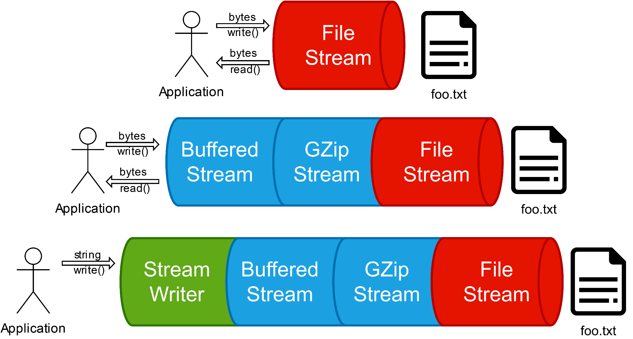
Composability of Streams

Slide 19
Reading and writing data
The FileStream class provides an implementation for the abstract Stream members in a manner appropriate for file-based streaming. It is a fairly primitive stream; it can read or write only a single byte or an array of bytes
http://www.csharp-examples.net/filestream-read-file/
The StreamWriter and StreamReader classes are useful whenever you need to read or write character-based data (e.g., strings). Both of these types work by default with Unicode characters; however, you can change this by supplying a properly configured System.Text.Encoding object reference.

Slide 20
Reading and writing data
Console.WriteLine("Enter file name");
string fn = Console.ReadLine();
// Open the file and display its contents
StreamReader reader = null;
try
{
reader = new StreamReader(fn);
for (string line = reader.ReadLine(); line != null; line = reader.ReadLine())
Console.WriteLine(line);
}
catch (IOException e)
{ Console.WriteLine(e.Message); }
finally
{
if (reader != null)
reader.Close();
}

Slide 21
Reading and writing data
StreamReader derives from an abstract type named TextReader, as does the related StringReader type. The TextReader base class provides a limited set of functionality to each of these descendants; specifically, it provides the ability to read and peek into a character stream.
The StreamWriter type (as well as StringWriter) derives from an abstract base class named TextWriter. This class defines members that allow derived types to write textual data to a given character stream.

Slide 22
Reading and writing data
Core Members of TextWriter
Member | Meaning
Close() | This method closes the writer and frees any associated resources. In the process, the buffer is automatically flushed (again, this member is functionally equivalent to calling the Dispose() method).
Flush() | This method clears all buffers for the current writer and causes any buffered data to be written to the underlying device; however, it does not close the writer.
NewLine | This property indicates the newline constant for the derived writer class. The default line terminator for the Windows OS is a carriage return, followed by a line feed (\r\n).
Write() WriteAsync() | This overloaded method writes data to the text stream without a newline constant.
WriteLine() WriteLineAsync() | This overloaded method writes data to the text stream with a newline constant.

Slide 23
Reading and writing data
The last two members of the TextWriter class probably look familiar to you. If you recall, the System.Console type has Write() and WriteLine() members that push textual data to the standard output device. In fact, the Console.In property wraps a TextReader, and the Console.Out property wraps a TextWriter.
The derived StreamWriter class provides an appropriate implementation for the Write(), Close(), and Flush() methods, and it defines the additional AutoFlush property. When set to true, this property forces StreamWriter to flush all data every time you perform a write operation. Be aware that you can gain better performance by setting AutoFlush to false, provided you always call Close() when you finish writing with a StreamWriter.

Slide 24
Reading and writing data
TextReader Core Members
Member | Meaning
Peek() | Returns the next available character (expressed as an integer) without actually changing the position of the reader. A value of -1 indicates you are at the end of the stream.
Read() ReadAsync() | Reads data from an input stream.
ReadBlock() ReadBlockAsync() | Reads a specified maximum number of characters from the current stream and writes the data to a buffer, beginning at a specified index.
ReadLine() ReadLineAsync() | Reads a line of characters from the current stream and returns the data as a string (a null string indicates EOF).
ReadToEnd() ReadToEndAsync() | Reads all characters from the current position to the end of the stream and returns them as a single string.

Slide 25
Reading and writing data
Methods of the File Type
Member | Meaning
ReadAllBytes() | Opens the specified file, returns the binary data as an array of bytes, and then closes the file
ReadAllLines() | Opens a specified file, returns the character data as an array of strings, and then closes the file
ReadAllText() | Opens a specified file, returns the character data as a System.String, and then closes the file
WriteAllBytes() | Opens the specified file, writes out the byte array, and then closes the file
WriteAllLines() | Opens a specified file, writes out an array of strings, and then closes the file
WriteAllText() | Opens a specified file, writes the character data from a specified string, and then closes the file

Slide 26
Reading and writing data
string[] myTasks = {"Repair water tap",
"Buy bread and milk",
"Study last C# features",
"Complete lecture materials",
"Phone to mum" };
File.WriteAllLines(@"D:\Mix\tasks.txt", myTasks);
foreach (string task in
File.ReadAllLines(@"D:\Mix\tasks.txt"))
{
Console.WriteLine("To do: {0}", task);
}

Slide 27
Reading and writing data
BinaryReader and BinaryWriter derive directly from System.Object. These types allow you to read and write discrete data types to an underlying stream in a compact binary format. The BinaryWriter class defines a highly overloaded Write() method to place a data type in the underlying stream. In addition to the Write() member, BinaryWriter provides additional members that allow you to get or set the Stream-derived type; it also offers support for random access to the data.
BinaryWriter Core Members
Member | Meaning
BaseStream | This read-only property provides access to the underlying stream used with the BinaryWriter object.
Close() | This method closes the binary stream.
Flush() | This method flushes the binary stream.
Seek() | This method sets the position in the current stream.
Write() | This method writes a value to the current stream.

Slide 28
Reading and writing data
BinaryReader Core Members
Member | Meaning
BaseStream | This read-only property provides access to the underlying stream used with the BinaryReader object.
Close() | This method closes the binary reader.
PeekChar() | This method returns the next available character without advancing the position in the stream.
Read() | This method reads a given set of bytes or characters and stores them in the incoming array.
ReadXXXX() | The BinaryReader class defines numerous read methods that grab the next type from the stream (e.g., ReadBoolean(), ReadByte(), and ReadInt32()).

Slide 29
Reading and writing data
FileInfo f = new FileInfo("BinFile.dat");
using (BinaryWriter bw = new BinaryWriter(f.OpenWrite()))
{ double aDouble = 1234.67;
int anInt = 34567;
string aString = "A, B, C";
bw.Write(aDouble);
bw.Write(anInt);
bw.Write(aString); }
using (BinaryReader br = new BinaryReader(f.OpenRead()))
{ Console.WriteLine(br.ReadDouble());
Console.WriteLine(br.ReadInt32());
Console.WriteLine(br.ReadString()); }

Slide 30
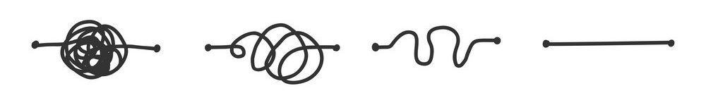
System.IO.FILe

Slide 31
System.IO.FILe
Provides static methods for the creation, copying, deletion, moving and opening of a single file and aids the creation of FileStream objects
Using one of the static methods provided by the File class, one can avoid using the stream directly.
All static methods of the File class accept the filename as a parameter.
The underlying stream is closed automatically after the method finishes execution.

Slide 32
Reading and writing data
File static methods
Member | Meaning
ReadAllText() WriteAllText() | Read/write all the text from/to the file specified as parameter and closes the file when finished.
ReadAllLines() WriteAllLines() | Read/write all the lines from/to the file specified as parameter and closes the file when finished.
ReadAllBytes() WriteAllBytes() | Read/Write all the bytes from/to the file specified as parameter and closes the file when finished
AppendAllText() | Add the specified text to the end of the file specified as parameter and closes the file when finished.
AppendAllLines() | Add the specified lines to the end of the file specified as parameter and closes the file when finished.

Slide 33
Monitoring file system
FileSystemWatcher class can be quite helpful when you want to monitor (or “watch”) files on your system programmatically. Specifically, you can instruct the FileSystemWatcher type to monitor files for any of the actions specified by the System.IO.NotifyFilters enumeration.
To begin working with the FileSystemWatcher type, you need to set the Path property to specify the name (and location) of the directory that contains the files you want to monitor, as well as the Filter property that defines the file extensions of the files you want to monitor.
At this point, you may choose to handle the Changed, Created, and Deleted events, all of which work in conjunction with the FileSystemEventHandler delegate. You can also handle the Renamed event using the RenamedEventHandler delegate type.

Slide 34
Monitoring file system
using var watcher = new FileSystemWatcher {
Path = ".", IncludeSubdirectories = true, EnableRaisingEvents = true };
watcher.NotifyFilter = NotifyFilters.Attributes
| NotifyFilters.CreationTime
| NotifyFilters.DirectoryName
| NotifyFilters.FileName
| NotifyFilters.LastAccess
| NotifyFilters.LastWrite
| NotifyFilters.Security
| NotifyFilters.Size;
watcher.Changed += (_, e) => Console.WriteLine($"changed {e.Name}");
watcher.Created += (_, e) => Console.WriteLine("Created");
watcher.Deleted += (_, e) => Console.WriteLine("Deleted");
watcher.Renamed += (_, e) => Console.WriteLine("Renamed");
Console.ReadLine();

Slide 35
Assignment
Add in your project possibility of saving some information in the file system.

Slide 36
References
Albahari J, Albahari B (2021). C# 9.0 in a Nutshell.
MSDN

